Slide 1
Serverless Confidential Containers: Challenges and Opportunities
Large-Scale Data & Systems Group
Carlos Segarra
(w/ Tobin Feldman-Fitzthum, Daniele Buono, and Peter Pietzuch) Large-Scale Data & Systems (LSDS) Group - Imperial College London
Visiting IBM TJ Watson (Sep'23 – Nov'23) https://carlossegarra.com <cs1620@ic.ac.uk>
Intelligent Serverless and Cloud Applications Symposium – Zurich 18/06/2024
Notes:
Aim for 30' presentation + Q&A

Slide 2
Agenda
1. Introduction to Confidential Serverless
- Characterising serverless functions: Cold/Warm starts and burstiness
- Problems with existing serverless offerings
2. Background:
- Design space for confidential serverless
- Kata and Confidential Containers
3. PoC: Knative on Confidential Containers
4. Evaluation
- Cold-Starts
- Warm-Starts
- Instantiation Throughput

Slide 3
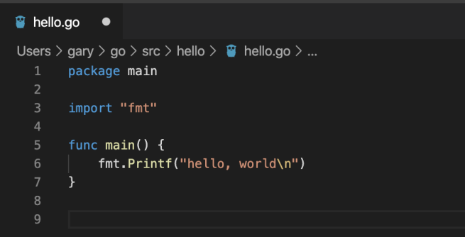
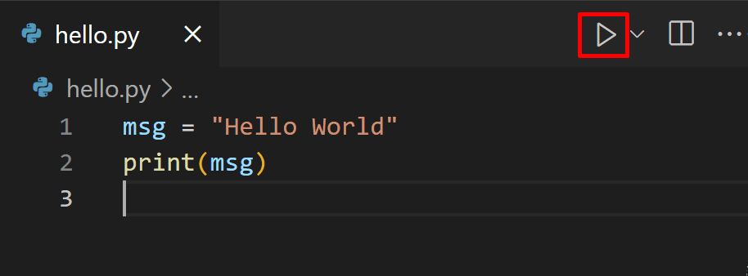
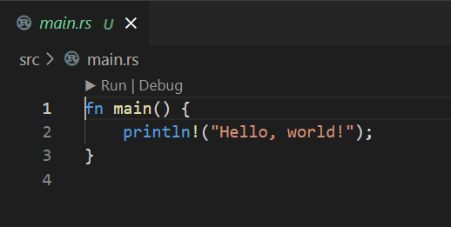
Introduction: Serverless Functions
Worker
Events
Frontend
Worker
Register
Worker
(Functions)
Notes:
For simplicity, and throughout the presentation, I will focus on one particular kind of long-running compute-intensive application; scientific applications.
Other kinds of long-running compute-intensvie applications would be, for example, ML model training.
Anyhow, scientific applications are still prevalent and very common place. Examples of such applications include:
Weather forecasting
Molecule dynamics simulations
Aerodynamics simulations

Slide 4
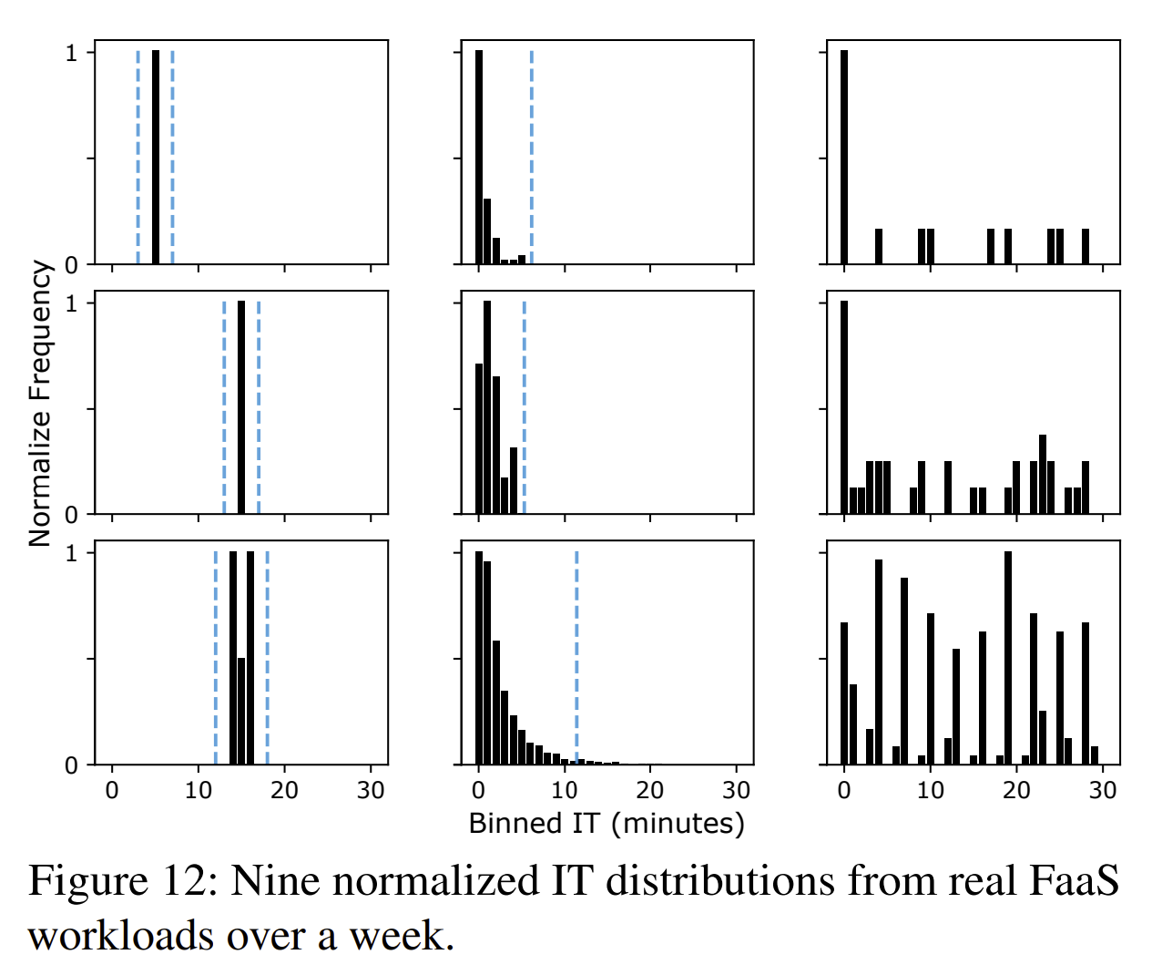
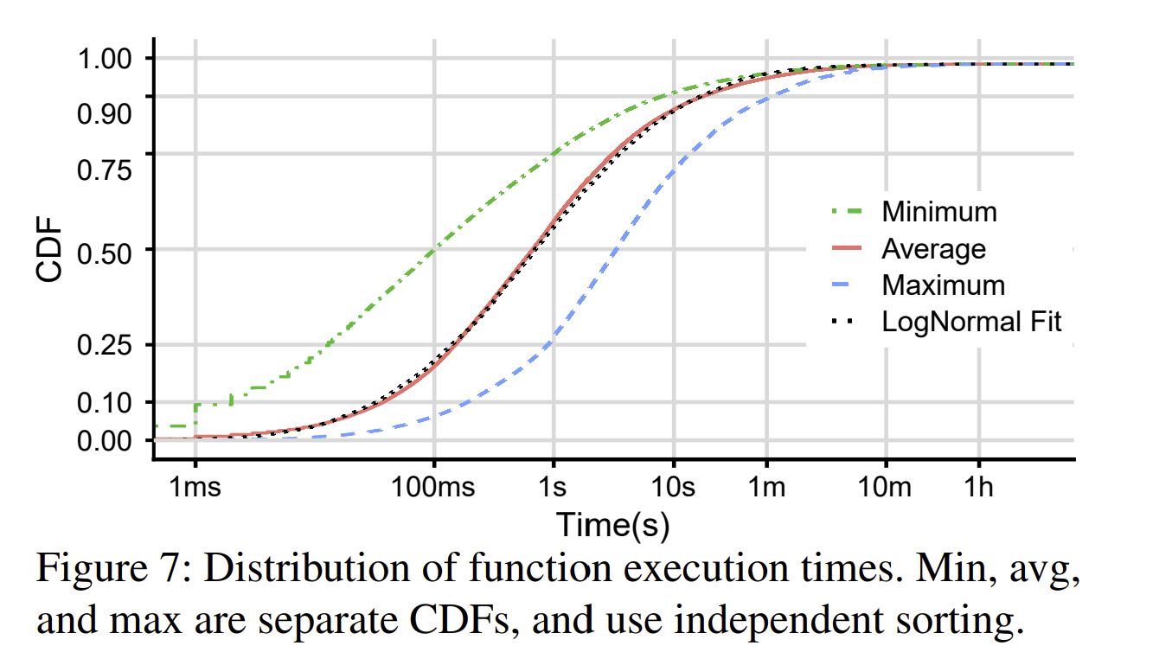
Introduction: Characterizing Serverless Functions
Functions are short-lived! (90% shorter than 10s)
Functions are bursty!
[ATC’20] Serverless in the Wild: Characterizing and Optimizing the Serverless Workload at a Large Cloud Provider

Slide 5
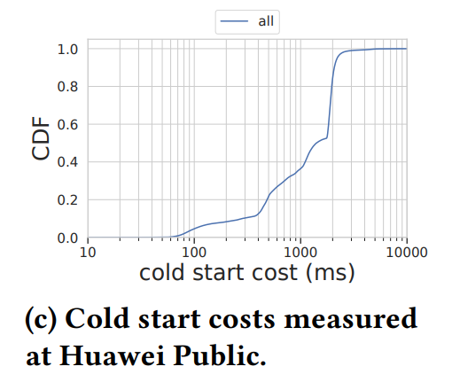
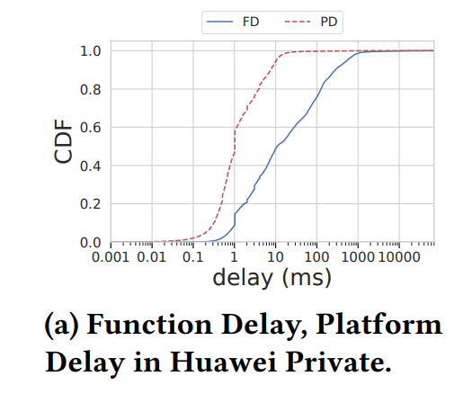
Introduction: Characterizing Serverless Functions
Only 40% of functions take less than 1s to start
Yet 80% of functions execute in < 100 ms !
[SoCC'23] How Does It Function? Characterizing Long-term Trends in Production Serverless Workloads

Slide 6
Introduction: Problems in Serverless
Cold-Start: how long does it take to serve a request for a new function?
Warm-Start: how long does it take to serve subsequent requests?
Instantiation Throughput: how many (concurrent) invocations of this function can we serve per second?
HTTP
Frontend
Worker
< 1s
50ms
15k cps
[ATC’23] On-demand Container Loading in AWS Lambda

Slide 7
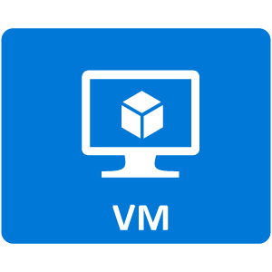
Introduction: Inter-Function Isolation in Serverless
VM-like Isolation is the only acceptable isolation mechanism
Security
Performance Tricks: micro-VMs, VM snapshots, and VM re-use
OCI images are the de-facto mechanism to express functions (and their dependency closure)
Performance
Usability

Slide 8
Introduction: More Problems in Serverless!
Inter-function isolation is fine, but not enough!
K8S Node
kubelet
Pod
Pod
Knative Service A
Knative Controller
Knative Sidecar
Srvc. A
Srvc. A
HTTP
Register

Slide 9
Introduction: More Problems in Serverless!
Inter-function isolation is fine, but not enough!
We need isolation from the host environment to guarantee...
- Data Confidentiality
- Code Confidentiality
- Execution Integrity
K8S Node
kubelet
Pod
Pod
Knative Service A
Knative Controller
Knative Sidecar
Srvc. A
Response (Srv. A?)
HTTP (Srv. A)
Confidential Computing

Slide 10
Background: Design Space for Confidential Serverless
K8S Node
kubelet
Pod
Pod
Process-Centric Security
Pod
Knative Service 1
Knative Service 2
Knative Controller
Knative Sidecar
Knative Sidecar
K8S Node
kubelet
Pod
Knative Service 3
Knative Sidecar

Slide 11
Background: Design Space for Confidential Serverless
K8S Node
kubelet
Pod
Pod
Process-Centric Security
Pod
Knative Service 1
Knative Service 2
Pod-Centric Security
Knative Controller
Knative Sidecar
Knative Sidecar
K8S Node
kubelet
Pod
Knative Service 3
Knative Sidecar

Slide 12
Background: Design Space for Confidential Serverless
K8S Node
kubelet
Pod
Pod
Process-Centric Security
Pod
Knative Service 1
Knative Service 2
Pod-Centric Security
Knative Controller
Knative Sidecar
Knative Sidecar
Node-Centric Security
K8S Node
kubelet
Pod
Knative Service 3
Knative Sidecar

Slide 13
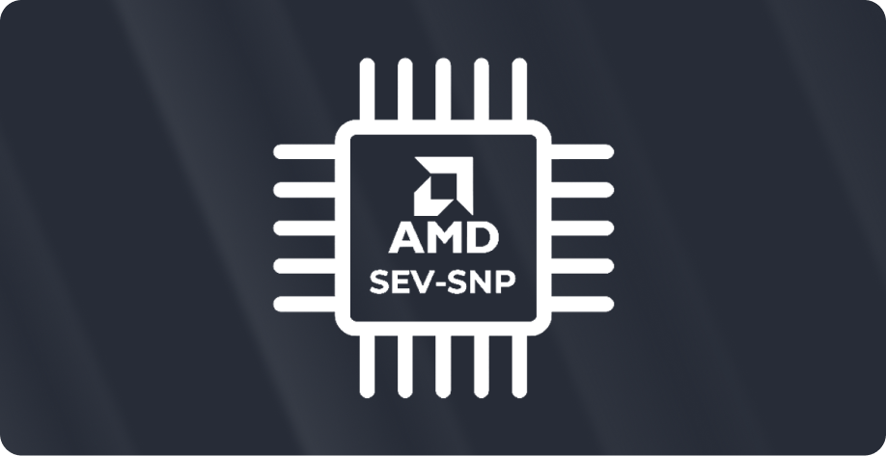
Background: Design Space for Confidential Serverless
K8S Node
kubelet
Pod
Pod
Process-Centric Security
Pod
Knative Service 1
Knative Service 2
Pod-Centric Security
Knative Controller
Knative Sidecar
Knative Sidecar
Node-Centric Security
K8S Node
kubelet
Pod
-TCB & Usability
+ TCB & Usability
Knative Service 3
- Attack Surface
+ Attack Surface
Knative Sidecar
Process-Centric
Pod-Centric
Node-Centric

Slide 14
Background: Design Space for Confidential Serverless
K8S Node
kubelet
Pod (cVM)
Pod (VM)
Pod
Pod (cVM)
Pod (VM)
Pod
Process-Centric Security
Pod
Knative Service 1
Knative Service 2
Pod-Centric Security
Knative Controller
Knative Sidecar
Knative Sidecar
Node-Centric Security
K8S Node
kubelet
Pod (VM)
Pod
Knative Service 3
Knative Sidecar
https://github.com/confidential-containers

Slide 15
PoC: Knative on Confidential Containers
kubectl apply ...
K8S Bare Metal Node
kubelet
CRI
Pod (cVM)
Pod (cVM)
containerd
Trusted Node
Kn
Service
Kn
Sidecar
Kn
Service
Kn
Sidecar
Attestation
+
Key Prov.
shim-v2
Guest Comp.
Guest Comp.
Key Broker Service (KBS)
kata-shim
Kata Agent
Kata Agent
Secrets DB
runc-shim
Guest Kernel
Guest Kernel
Pod (ns)
Hypervisor (QEMU + KVM)
Kn Control Plane
Host Kernel

Slide 16
PoC: Attestation of Knative on CoCo (AMD SEV)
Container Registry
K8S Bare Metal Node
Secure Boot Protocol
Kn
Service
Kn
Sidecar
AMD PSP
Ahead-of-Time
kubelet
Trusted Node (RP)
Generate launch measurement
Encrypt private container images
Sign all container images
CRI
KBS
containerd
Launch SHA
shim-v2
kata-shim
Kn
Service
Kn
Sidecar
runc-shim
SEV Version: …
OVMF Image: …
Kernel Image: …
Kernel CMD: …
initrd: …
Pod (ns)
QEMU + KVM
Kn Control Plane
Host Kernel
User
(Guest Owner)

Slide 17
PoC: Attestation of Knative on CoCo (AMD SEV)
Container Registry
K8S Bare Metal Node
Secure Boot Protocol
Kn
Service
Kn
Sidecar
AMD PSP
Ahead-of-Time
kubelet
Trusted Node (RP)
Pod (cVM)
Generate launch measurement
Encrypt private container images
Sign all container images
CRI
KBS
Kn
Service
Kn
Sidecar
containerd
KBC
image-rs
Launch SHA
shim-v2
Run-time
Kata Agent
cVM pre-attestation
OVMF boot
Direct measured kernel boot
Kata Agent as /init in initrd
Pull encrypted/signed images
Request key material
Validate Image Signature
Decrypt Layers
kata-shim
Guest Kernel
runc-shim
OVMF
Pod (ns)
Kernel_SHA
Initrd_SHA
QEMU + KVM
Kn Control Plane
Host Kernel

Slide 18
Evaluation
We want to evaluate the feasibility of our PoC according to the three key metrics for serverless:
1. Cold Start Times
2. Warm Start Times
3. Scale-Out (0->16)
6s
1s
16 s
7s
2s
17 s
??
??
??

Slide 19
Evaluation: Baselines
K8S Bare Metal Node
0. docker (i.e. runc): no VMs
1. kata: VMs
2. coco-nosev: + pull in guest
3. coco-nosev-ovmf: + OVMF
4. coco: + SEV
5. coco-fw: + HW att
6. coco-fw-sig: + image signature
7. coco-fw-sig-enc: + image enc.
kubelet
Pod (cVM)
CRI
Pod (VM)
Kn
Service
Kn
Sidecar
containerd
shim-v2
KBC
image-rs
Kata Agent
kata-shim
Guest Kernel
runc-shim
SeaBIOS
OVMF
Pod (ns)
Kernel_SHA
Initrd_SHA
QEMU + KVM
Kn Control Plane
Knative Service is a simple "Hello World" in Python
Host Kernel

Slide 20
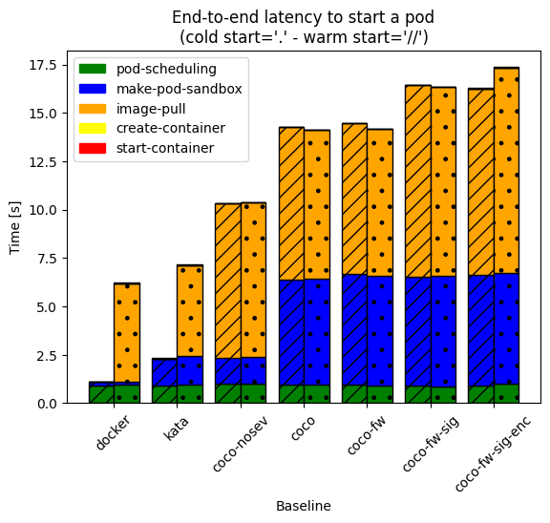
Evaluation: Cold/Warm Starts
Observations:
Why is VM start-up 4x slower with SEV?
Why is image pulling 2-3x slower w.r.t docker?
Why are there no warm starts?
Additional 10 s!
Let us address these questions one by one

Slide 21
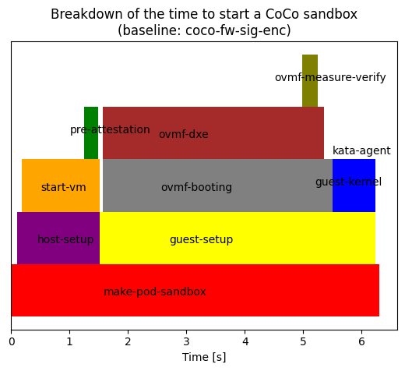
Evaluation: VM Start-Up in detail
Q1: Why is VM start-up 3x slower with SEV?
A: It seems that we spend a lot of time in OVMF...

Slide 22
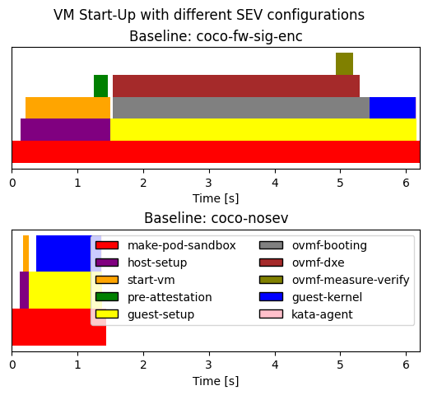
Evaluation: VM Start-Up in detail
Q1: Why is VM start-up 3x slower with SEV?
start-vm: Provisioning guest memory (pages introduces 1-2 extra seconds (for 2GB of memory)
50-100x in virtual FW!
10x in start-vm (i.e. QEMU cmd)
virtual-fw: OVMF DXE driver initialization introduces 3-4 extra seconds

Slide 23
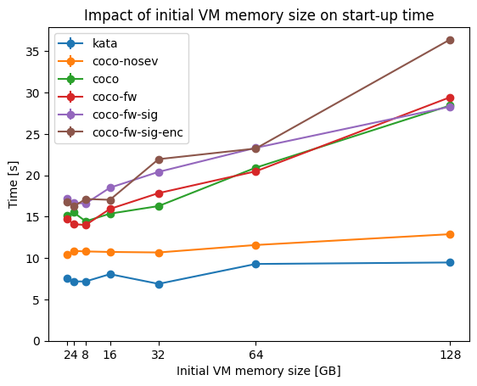
Evaluation: VM Start-Up in detail (ctd)
Q1: Why is VM start-up 3x slower with SEV?
A: During the start-vm phase, QEMU provisions all the memory pages assigned to the guest

Slide 24
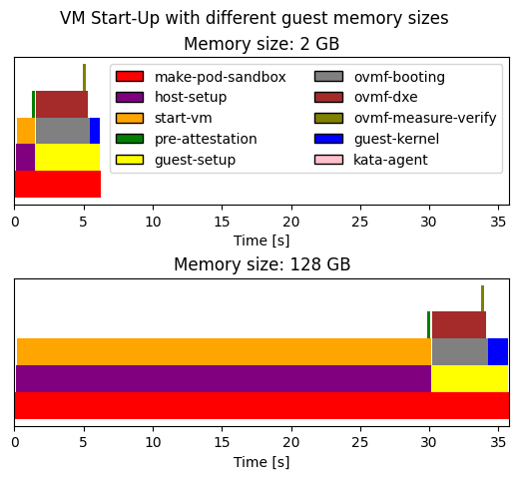
Evaluation: VM Start-Up in detail (ctd)
Q1: Why is VM start-up 3x slower with SEV?
A: During the start-vm phase, the PSP provisions all the memory pages assigned to the guest
Suggested Solution:
Can we assign memory pages lazily, off the hot-path?
Serverless CoCo Task 1: Optimize cVM provisioning

Slide 25
Evaluation: VM Start-Up in detail
Q1: Why is VM start-up 3x slower with SEV?
A: It seems that we spend a lot of time in OVMF...

Slide 26
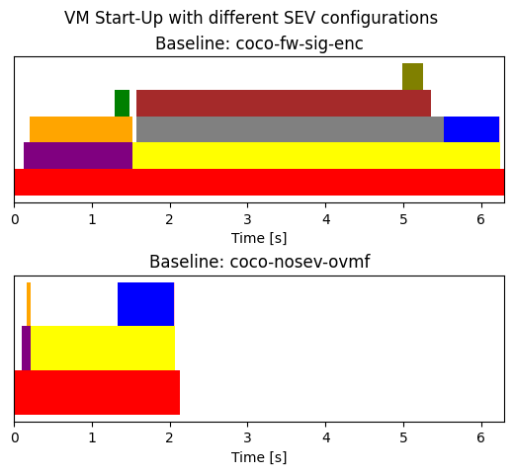
Evaluation: VM Start-Up in detail
Q1: Why is VM start-up 3x slower with SEV?
A: We spend 3-4 more seconds in OVMF
A: It seems that we spend a lot of time in OVMF...
A: Compared to a non-SEV VM (w/ OVMF) we spend:
4-5x in virtual FW!
Q: What is the difference between SEV/non-SEV OVMF?
A: For SEV, we measure and verify kernel/initrd/cmdline

Slide 27
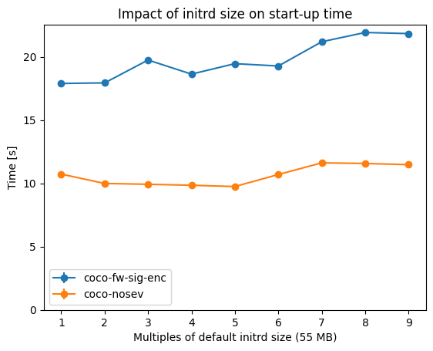
Evaluation: VM Start-Up in detail
Q1: Why is VM start-up 3x slower with SEV?
A: We spend 3-4 more seconds in OVMF
A: It seems that we spend a lot of time in OVMF...
A: Compared to a non-SEV VM (w/ OVMF) we spend:
Q: What is the difference between SEV/non-SEV OVMF?
A: For SEV, we measure and verify kernel/initrd/cmdline

Slide 28
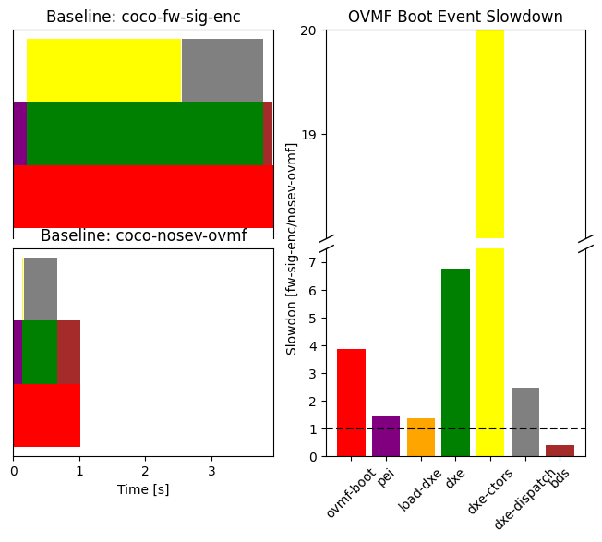
Evaluation: VM Start-Up in detail
Q1: Why is VM start-up 3x slower with SEV?
A: We spend 3-4 more seconds in OVMF
A: It seems that we spend a lot of time in OVMF...
A: Compared to a non-SEV VM (w/ OVMF) we spend:
Blob measurement/verification happens here
This behaviour is unexpected
(we are in contact w/ AMD about it)
20x initializing drivers!

Slide 29
Evaluation: Cold/Warm Starts
Observations:
Why is VM start-up 4x slower with SEV?
Why is image pulling 2-3x slower w.r.t docker?
Why are there no warm starts?
Problem: Provisioning guest memory pages introduces 1-2 extra seconds (for 2GB of memory)
Solution: Hot-Plug guest memory pages (or provision off the hot path)
Problem: OVMF DXE driver initialization introduces 3-4 extra seconds
Solution: Not clear! Talk to AMD folks!

Slide 30
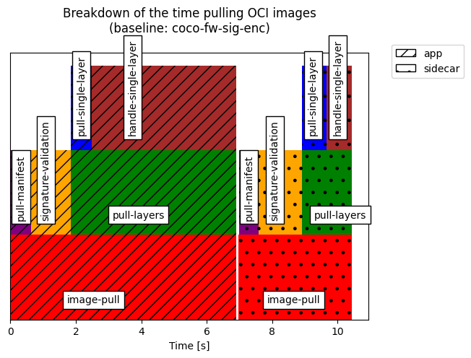
Evaluation: VM Start-Up in detail
Q2: Why is image-pulling 2x slower w.r.t Docker?
A: containerd's PullImage becomes blocking!
A(ctd): Decrypting image layers is the bottleneck!
decompress + decrypt
decompress
Time pulling app. Image
(encrypted + signed)
"" sidecar Image
(signed)

Slide 31
Evaluation: VM Start-Up in detail
Q3: Why are there no warm starts?
A: SEV guests are cryptographically bound to one "guest owner"
A: Cannot rely on the host to mount container images
A: Cannot easily share (or lazy load) encrypted image layers
Suggested Solutions:
Use the KBS as trusted relying-party in VM pre-warm
Freeze the Kata Agent until pre-warmed VM is assigned
Encrypted block-based lazy image loading (Nydus)
Label image layers as encrypted or not
Serverless CoCo Task 3: Design Secure CoCo sandbox re-use strategies
Notes:
Mention that warm starts are a kind of non-issue, or are outside the scope of, CoCo.
Instead, benefits in Kata like VM cache will transitively (if applicable) benefit CoCo.

Slide 32
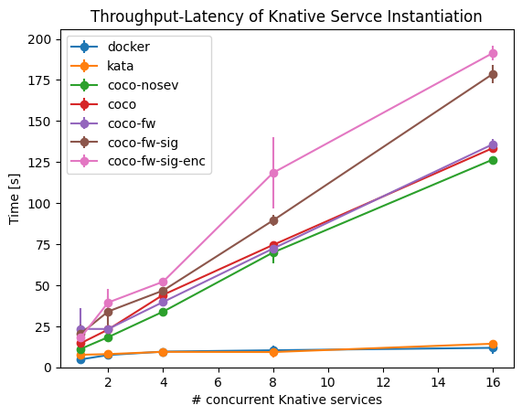
Evaluation: Instantiation Throughput
Starting 16 concurrent functions takes > 3' !!

Slide 33
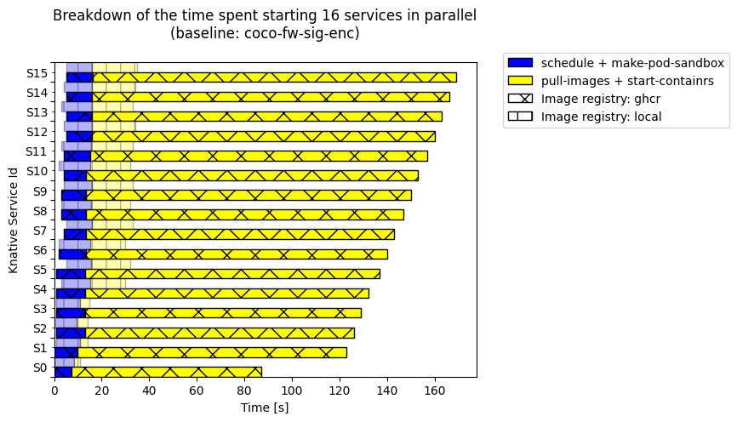
Evaluation: Instantiation Throughput (ctd.)
Q: Why Starting 16 concurrent functions takes > 3'?
A: We are being throttled by the registry!
Notes:
For reference, mention that pulling an image from a local registry would also be a kind of "warm start" for CoCo

Slide 34
Evaluation
We want to evaluate the feasibility of our PoC according to the three key metrics we identified for serverless:
1. Cold Start Times
2. Warm Start Times
3. Scale-Out (0->16)
6s
1s
16 s
7s
2s
17 s
17.5 s
17.5 s
190 s

Slide 35
Summary: Serverless Confidential Containers
Confidential Containers are a promising isolation mechanism for serverless due to its seamless integration w/ images and VMs.
However, in their current implementation their performance overheads make adoption in production unfeasible.
1. Cold Start
2. Warm Start
3. Scale-Out
6s
1s
16 s
7s
2s
17 s
17.5 s
17.5 s
190 s
Q & A
Carlos Segarra, Tobin Feldman-Fitzthum, Daniele Buono, and Peter Pietzuch
Serverless Confidential Containers: Challenges and Opportunities.
SESAME '24 @ EuroSys
https://carlossegarra.com <cs1620@ic.ac.uk>

Slide 36
FYP CoCo: Summary
Slowdown
1. Cold Start Times
2. Warm Start Times
3. Instantiation Throughput
2.5x
8.75x
5x
cVM Start-Up Overhead
Guest Memory Pages Provisioning
OVMF DXE Initialization
No CoCo pre-warming
SEV Guests <-> owner
Registry Throttling
If all CoCo's pull from the guest, cannot scale w/out pass-through cache
Will benefit from improvements in warm starts
No Image Re-Use
Cannot mount images from host
Cannot share images between tenants
Cannot lazy load images
Guest-Side Image Pulling
Serial (per-ctr) pulling
Image Layer Decryption

Slide 37
Serverless Confidential Containers: Challenges and Opportunities
Large-Scale Data & Systems Group
Carlos Segarra
(w/ Tobin Feldman-Fitzthum and Daniele Buono) Large-Scale Data & Systems (LSDS) Group - Imperial College London
Visiting IBM TJ Watson (Sep'23 – Nov'23) https://carlossegarra.com <cs1620@ic.ac.uk>
IBM TJ Watson – Thursday, November 16th 2023
Notes:
Aim for 30' presentation + Q&A

Slide 38
FYP CoCo: Summary
Confidential Containers are a very promising technology for zero-friction adoption of confidential computing in the cloud. However...
still very far from being usable in challenging environments like serverless!
Good news is that there is a lot of low-hanging fruit!
Serverless CoCo Task 1: Optimize cVM provisioning
Serverless CoCo Task 2: Optimize Image Pulling Time
Serverless CoCo Task 3: Design Secure CoCo sandbox re-use strategies
Serverless CoCo Task 4: Improve Scalability of CoCo sandbox provisioning

